Slide 1
Recommendation System for Soccer Transfer Market
"A football team is like a beautiful woman. When you do not tell her, she forgets she is beautiful." - Arsene Wenger
Anirudha Jitani

Slide 2
Problem Statement
Recommend players (market value) for the upcoming transfer season to improve the current squad (constrained budget).

Slide 3
Inspiration
The math works. Over the course of a season, there's some predictability to baseball. When you play 162 games, you eliminate a lot of random outcomes. There's so much data that you can predict: individual players' performances and also the odds that certain strategies will pay off.
-Billy Beane
In 2002, the Athletics became the first team in the 100+ years of American League baseball to win 20 consecutive games by applying sabermetric methods.

Slide 4
HOWEVER SOCCER IS MUCH MORE COMPLICATED !!

Slide 5
What are we trying to do?
Predict the market value of the player based on input feature
Predict the Form of the player based on his last 5 year performance
Derive an equation for Impact Score of the player (combination of player potential and recent history)
Calculate the MVP of the player which is a function of Market Value and Impact Score
Use constrained programming to come up with a set of optimal recommendations for the transfer market.

Slide 6
Datasets
FIFA 18 All Player Database
Fantasy Points and Player Statistics for Top 5 Leagues in Europe
Scraping Websites for League Performance Data
Manually Searching and Gathering Transfer Budget for Clubs

Slide 7
Challenges
DATA (more than 90% time)
1-1 Mapping between different datasets (Manual annotation) - ~ 2 hrs to run once
Important Data points missing for calculating impact score (match-winning goals/assists, penalty wins, accuracy etc)
Incomplete Data in FIFA (not all clubs in Top 5 are listed)
No PRIOR Work for Model Creation and lot of constraints
Manually creating different functions for Impact Score.

Slide 8
Methods
Predicting the Market Value of the Player
Supervised learning using Ridge Regression (alpha = 0.01) and Feed-forward Neural Network (1024 * 1024 * 1024 hidden layers)
Input Feature - 75+ input features like FIFA attributes, Transfer Release Clause, Age, Characteristics on and off fields
RMSE - 696431 (value in millions - upto 100 million)
Score - almost perfect 1.0 (17994 data-points, 75+ features) - NN
0.9597 - Ridge with alpha = 0.001

Slide 9
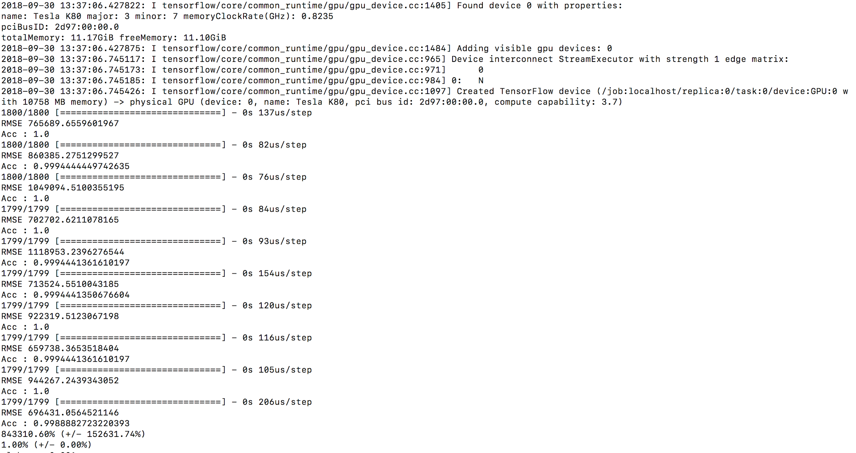

Slide 10
Methods
2. Predicting Form of Past Seasons
Supervised learning using Ridge Regression and Feed-forward Neural Network (1024 * 1024 * 1024 hidden layers)
Input Feature - 18 input features like Goals, Assists, Cards, Fantasy Points, Appearances, etc
Score - Very low as we don’t have good features(3923 data points - 18 features and variability in actual performance, not so easily modelled.

Slide 11
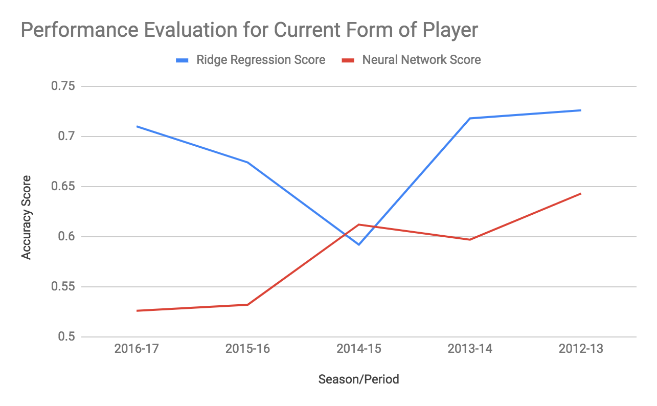

Slide 12
Methods
3. Calculating the Impact Score
Evaluate different methods to calculate the form of the player based on the forms of the past 5 years form. (Weight Decay)
Semi Supervised Learning to infer the “Impact Score” of the player based on the different weights on Overall FIFA score and Form obtained from the above model.

Slide 13
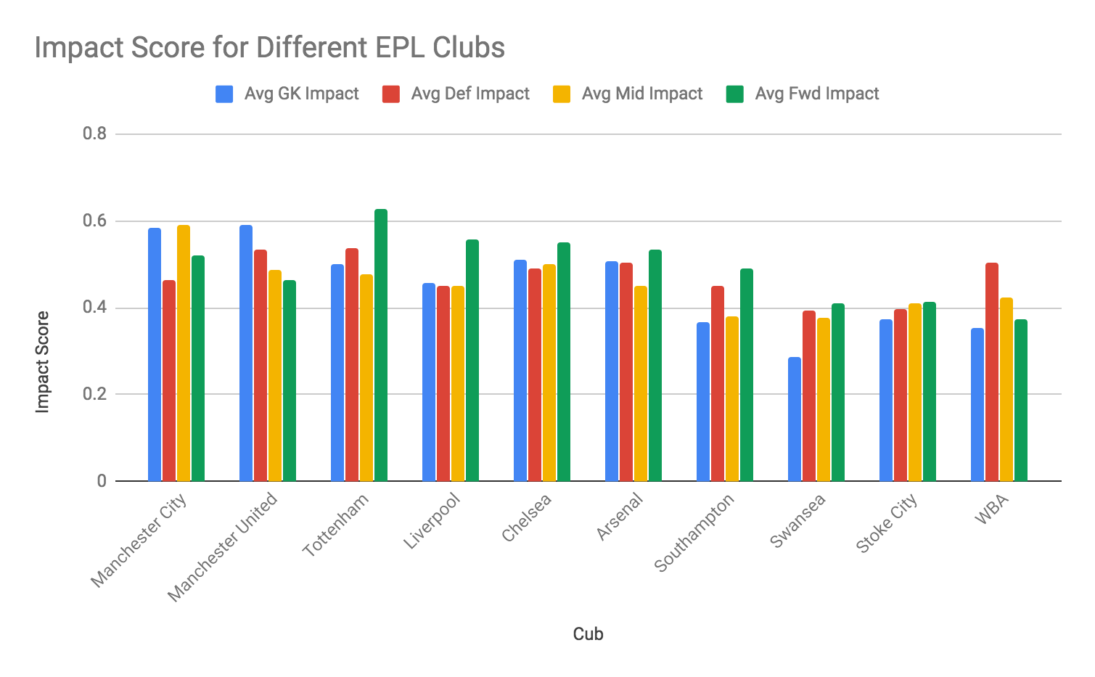

Slide 14
Methods
4. Team’s Last Season Performance (for Top 5 Leagues)
Analyse the area of weakness (defence, attack) by normalizing Goal Scored, Goal Conceded, W/D/L ratio with respect to rest of the teams.

Slide 15
Methods
5. Constrained Programming (NOT IMPLEMENTED)
Find multiple solutions of optimal team by replacing as few players as possible while maximising the impact score.
Constraints - Budget (Market Value + Weekly Wage), Squad Size, Player Position
Challenges - Trade-off between quality and quantity
Trade-off between positions (attacker vs defender)
Brute-Force is not practical

Slide 16
Future Work
Getting the time-constraint working to get the optimal solutions
Collecting more data points to improve our Form Accuracy
NLP on Football Commentary to infer important events of a match
Applying Game Theory (Online Learning Theory) to implement strategies against specific teams.
Optimized-Squad Selection and strategies based on Frame Analysis and heat-maps.

